Slide 1

Analysis of Motor Vehicle Crashes
(2014,2015 and 2016)

Slide 2
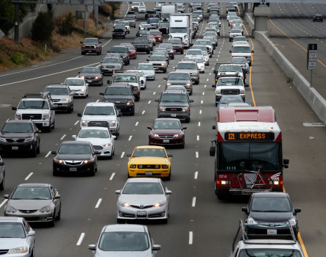
The United States
Overview
Busiest Country in terms of road traffic:
264 million vehicles registered
218 million drivers
Number of collisions/accidents have increased significantly…
Multiple factors contributing to accidents – road safety, driver skill, impairment due to alcohol, notably speeding etc
Important to understand the top causes contributing to increase in accidents and take actions to increase safety

Slide 3
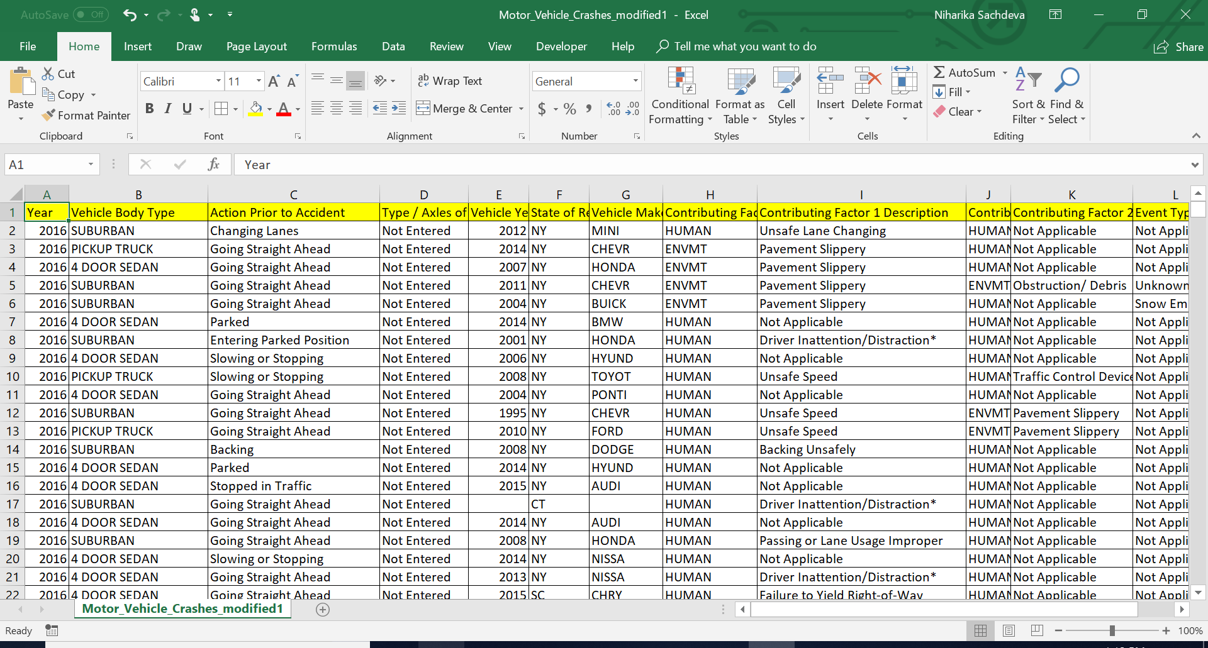
Data Used for Analysis (data.gov)

Slide 4
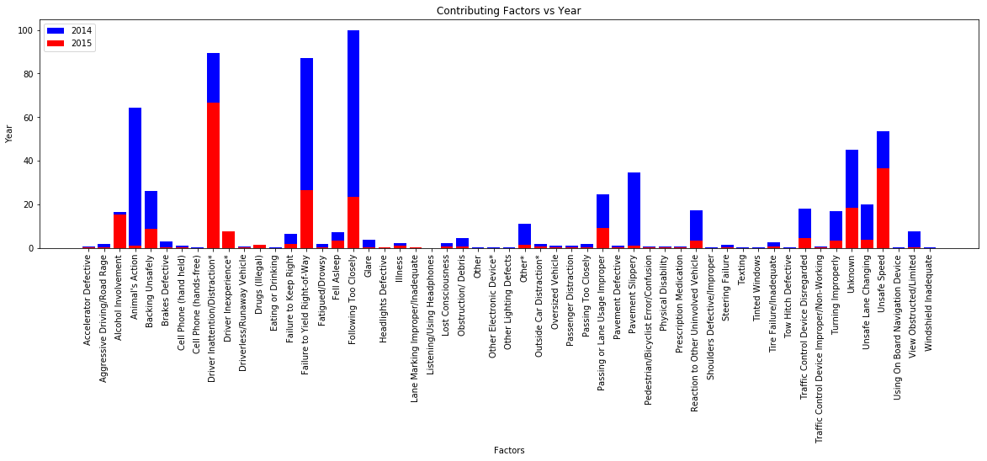
Top 5 factors contributing to Accidents
87043 Accidents in 2014, 2015
Top 5 factors contributing to accidents:
Following too closely
Driver Inattention/distraction
Failure to yield right-to-way
Animal’s action
Unsafe speed

Slide 5
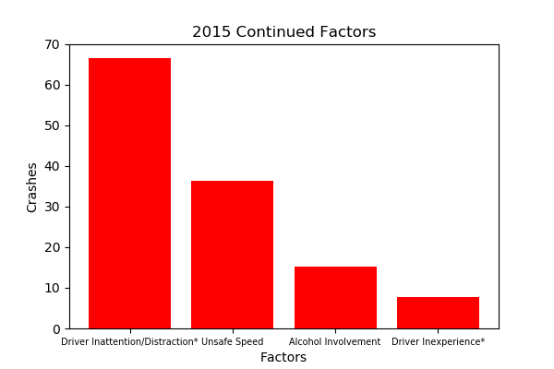
Factors contributing to Accidents – Continued in 2015
Driver Inattention/distraction
Unsafe speed
Alcohol Involvement
Driver Inexperience
Inference
Increased traffic enforcement
Stringent control/penalties on alcohol involvement, use of mobile phones while driving
Improved driving habits.

Slide 6
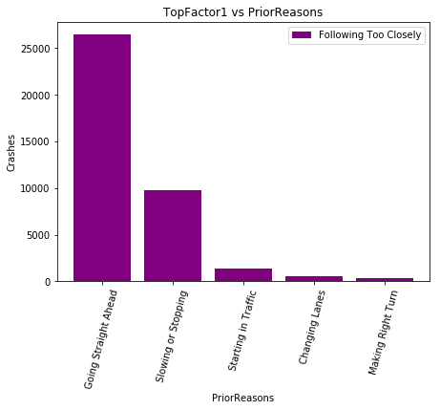
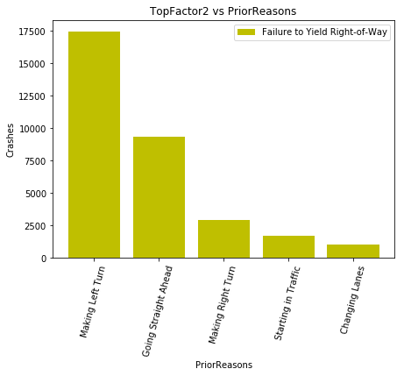
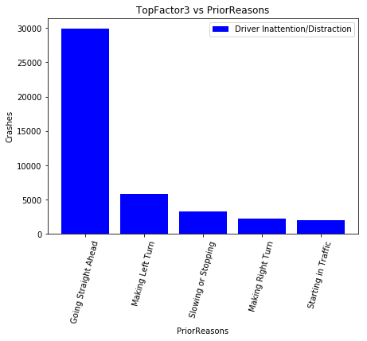
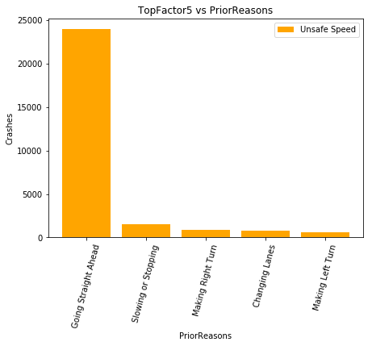
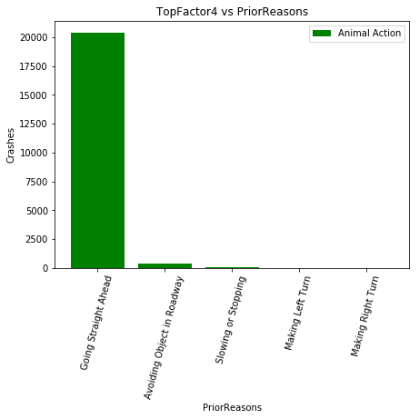
What happened before the accidents?
Prior Reasons before the accident for top five contributing factors and inferred the following:
Going straight ahead is common across all accident types. Which means that its not caused by the car but due to human causes – bad driving habits, alcohol involvement, speeding etc.
Making Left turn,
Slowing or stopping is another common occurrence:

Slide 7
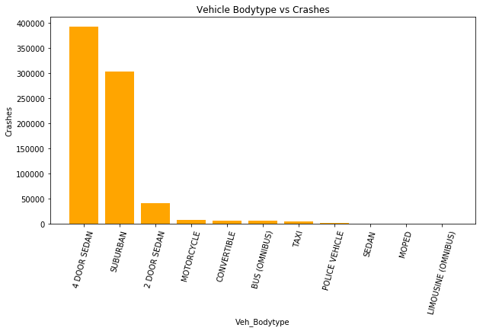
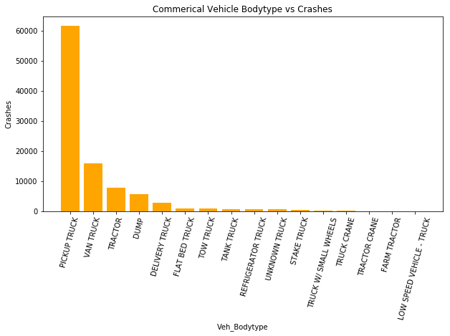
Which Vehicles are prone to accidents?
Commercial Vehicles
Pickup Truck shows the maximum
count
Commercial Vehicle Body Type
Passenger Vehicles
Sedan Cars encountered max crashes.
Suburban is the next.

